Slide 1
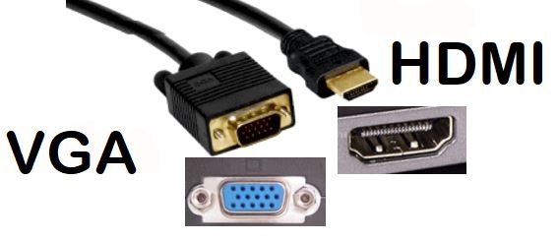
VGA and HDMI Ports

Slide 2
VGA and HDMI ports
Video Graphics Array (VGA) and High-Definition Multimedia Interface (HDMI) are interface standards used for cables that connect devices — such as laptop computers and DVD players — to a display, like a TV, computer monitor or projector.
VGA carries only a video signal.
HDMI is the default cable standard for newer electronic devices, such as Blu-Ray players or LED TVs.
HDMI can carry both digital video and audio signals, all while encrypting data with HDCP.
The video quality attained with a VGA cable is noticeably worse when compared to that of HDMI.
High Bandwidth Digital Content Protection

Slide 3
VGA and HDMI ports
VGA can only accommodate a single video signal and nothing else. This means that any other signal would need another cable to pass.
HDMI is much more capable as it was developed to carry signals between an HD TV set and a set top player. It can carry a video signal, up to 8 channels of digital audio, and a CEC channel for communication between devices. It is very convenient as you would only need one cable to connect to devices instead of 3 to 8 cables.

Slide 4
VGA and HDMI ports
When it comes to ports, VGA uses a 15-pin connector, usually marked with a blue.
There are several versions of HDMI cables, Type A – Type E, but the most common one is HDMI A which has 19 small pins.
The maximum possible resolution on VGA is 2048×1536, although you should expect ghosting and other visual issues at this resolution.
HDMI, on the other hand, can support a wide range of resolutions, without the risks of signal interference or loss.
HDMI is much stable, and it has a built-in data encryption feature, called HDCP.
HDMI also carries over audio, and newer versions can carry over the internet too.

Slide 5
VGA and HDMI ports
Summary: 1.VGA is an analog video standard while HDMI is in digital 2.VGA is very old while HDMI is still pretty new 3.VGA can only carry a video signal while HDMI can carry a lot of signals other signals along with video 4.VGA is usually used in computers while HDMI is used in HD tv sets and media players

Slide 6
VGA and HDMI ports
Lets think……..
1) Which one is Better to Watch Movies?
2) Which One is Better for Gaming?

